Slide 1
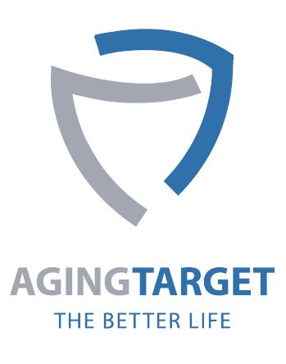
Investment Opportunities
Pharmaceutical/Healthcare: Anti-atherosclerotic drugs, Anti-Alzheimer’s drugs
Investment Highlights
Atherosclerosis Drugs Industry Trends and Market Size – Due to the nature of cardiovascular diseases, complete cures are nearly impossible, and the increasing prevalence continues to create significant unmet medical demand, leading to anticipated continuous market growth. The atherosclerosis drugs market was valued at $17.6 billion in 2025 and is projected to grow at a compound annual growth rate (CAGR) of 3.63% during the forecast period from 2025 to 2034, reaching an estimated $24.3 billion by 2034.
Alzheimer’s Drugs Industry Trends and Market Size - Prior to 2019, the Alzheimer’s drugs market was on a decline due to the limited effectiveness of existing treatments. However, with several pharmaceutical companies recently introducing new therapies, the market is once again gaining attention. The global market for Alzheimer’s drugs was valued at approximately $6.5 billion in 2025 and is expected to grow at a CAGR of about 20%, reaching an estimated $33.6 billion by 2034.
Product & Service
Product & Technology
Key characteristics of core technology
- Anti-atherosclerotic drugs targeting vascular senescence is an innovative therapy proposing a new drug development paradigm for cardiovascular diseases.
- The company is developing a highly effective anti-Alzheimer’s drugs that target not only amyloid β but also tau and synaptic toxicity which are other important pathogenic factors of Alzheimer’s disease.
Competitiveness of core technology
- Anti-atherosclerotic drugs targeting vascular senescence hold the potential for fundamental therapeutic effects.
- Multi-target anti-Alzheimer’s drugs can target multiple factors, including amyloid β, tau, and even synaptic plasticity/synaptic toxicity.
Indications
Therapy
Problems to solve
R&D Direction
Atherosclerosis
Anti-atherosclerotic drugs targeting vascular senescence
Focused on lowering LDL-C
Continued use due to temporary effects
Novel drugs targeting vascular senescence
The number of medications is expected to be drastically reduced due to the fundamental therapeutic effect.
Alzheimer’s dementia
Multi-target anti-Alzheimer’s drugs
Focused on a single target of amyloid β
Limited therapeutic effects
Targeting multiple factors, including Tau and Synaptotoxicity along with amyloid β
Enhancement of therapeutic effects
Pipeline – Expected to enter preclinical trials in 2026–2027
[Major Intellectual Property Rights]
Category | No. | Intellectual Property Rights
Patent/registered | 10-1717709 | Saikosaponin C as a regulator of causative proteins in Alzheimer's disease
Patent/registered | 10-2919453 | Composition containing Saikosaponin C for treating or preventing atherosclerosis
Patent/registered | 7837595 | 動脈硬化を含む老化関連血管疾患の治療又は予防用組成物としてのサイコサポニンＣ
Patent/filed | 18/844,658 | SAIKOSAPONIN C AS COMPOSITION FOR TREATING OR PREVENTING AGE RELATED VASCULAR DISEASES INCLUDING ARTERIOSCLEROSIS
Patent/filed | 23767099.7 | SAIKOSAPONIN C AS COMPOSITION FOR TREATING OR PREVENTING VASCULAR DISEASES INCLUDING ARTERIOSCLEROSIS
Patent/filed | 202380025650.9 | 作为用于治疗或预防包括动脉硬化在内的老化性血管疾病的组合物的柴胡皂苷C
Patent/filed | 10-2025-0153843 | Novel compounds and pharmaceutical compositions thereof

Slide 2
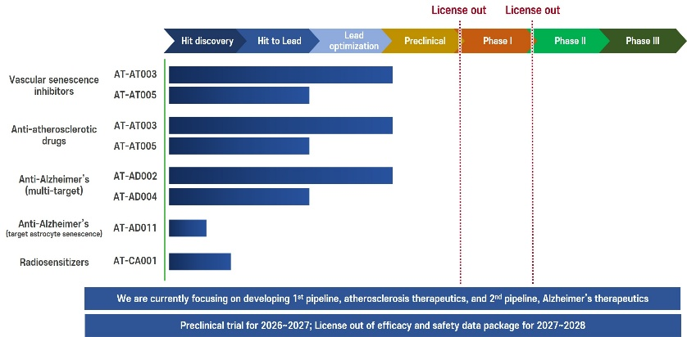
Company Profile
Date of establishment | January 11, 2021
Public | No
Patent and certification | 7 patents for diseases such as Alzheimer's and atherosclerosis have been filed/registered domestically and internationally
ESG activities and plans | Using a filter-based fume hood to minimize the emission of pollutants. Currently hiring highly experienced researchers aged 65 and above.
Investment performance | Yes
Investment stage | Series A
Investor | Withus Pharmaceutical Co., Korea Credit Guarantee Fund, Korea Venture Investment Corp., Korea BIO Invest Partners
Recent investment amount | KRW 1,500 million
Cumulative investment amount | KRW 2,300 million
Recent investment date | June 14, 2024
Traction
Value (million USD)
Preclinical trial & IND filing
Since its founding in 2021, the company has identified hit compounds and lead compounds. Subsequently, it conducted the synthesis of new structural derivatives of the identified lead compounds and the lead optimization process. Currently, it is developing new drug candidates ready to enter preclinical trials.
Preclinical trials are planned for 2026-2027, with an IND submission targeted for 2027. Depending on the company's needs, a technology transfer (license-out) to a global pharmaceutical company could be considered after completing preclinical trials or after completing Phase 1 clinical trials.
30
9
Lead optimization
6
Derivative synthesis
4
Hit identification
Lead identification
3
8
10
8
10
2
4
2021.01
2021.06
2022
2023
2024
2025
2026~2027
Business Plan
The preclinical trials for new drug candidates targeting atherosclerosis and Alzheimer's disease are planned for 2026–2027.
Following completion of Phase 1 clinical trial or preclinical trial, the goal is to package efficacy and safety data for licensing out to global pharmaceutical companies.
Investment Requirement
Investment Structure | Equity Investment, Joint Venture, M&A
Amount | 3.7 million USD
Region | North America, China, Europe, Japan, South-East Asia, Middle-East Asia

