Slide 1

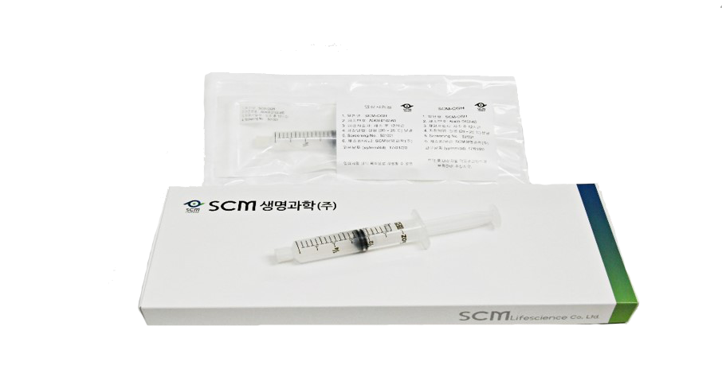
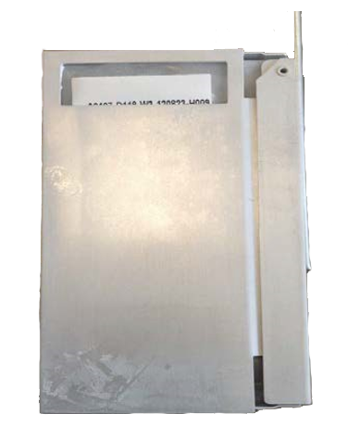
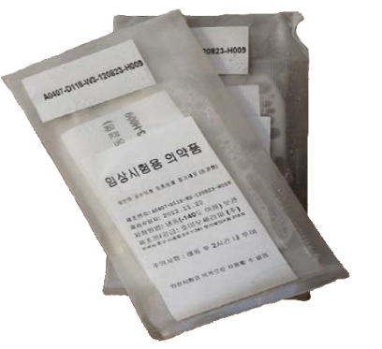
SCM Pipelines
Formulation
SCM-CGH (Fresh)
SCM-AGH (Frozen)
Main Ingredient | Allogeneic Bone Marrow-derived MSC | 5M cells/mL Prefilled Syringe
Excipient | Saline
pH Regulator | CaCl₂ (USP)
Storage Temperature | 4-30 ℃
Main Ingredient | Allogeneic Bone Marrow-derived MSC | 20 M cells/bag/6 mL 40 M cells/bag/12 mL
Cell Stabilizer | Plasma Solution A
 | Albumin
 | DMSO
Storage Temperature | Liquid Nitrogen Tank ( below -140 ℃ )

